Slide 1
DO NOT TOUCH THE COMPUTER!
Notes:
http://www.pngall.com/rocket-png

Slide 2
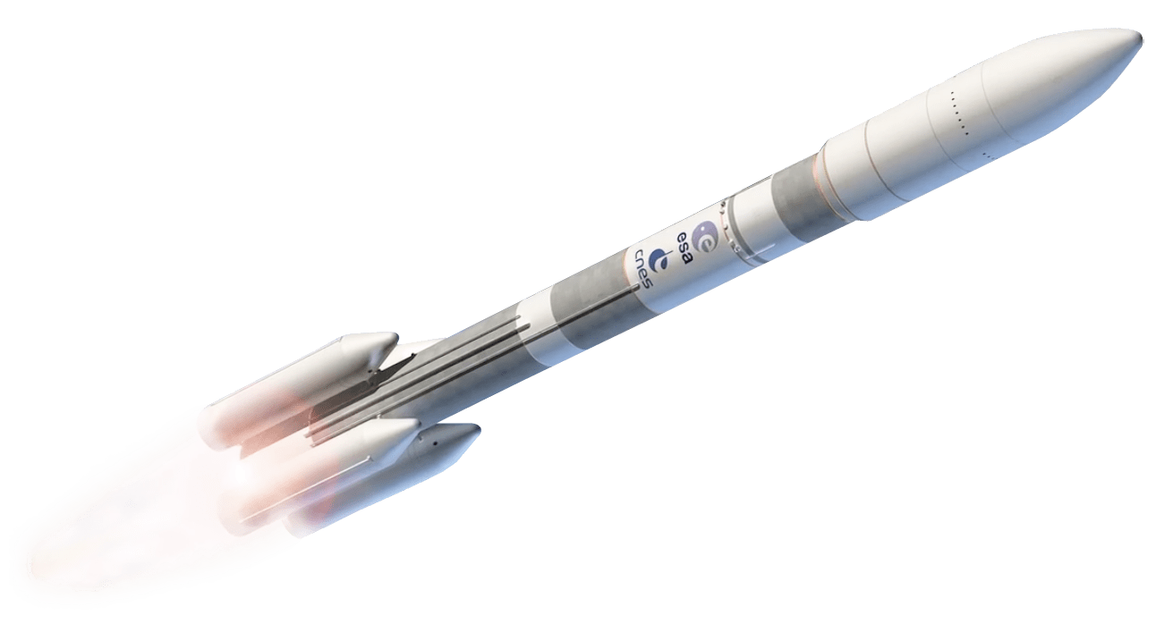
Python Workshop
National Open Day
Monday, 21st of October 2019
Benjamin De Bosscher
Notes:
http://www.pngall.com/rocket-png

Slide 3
Content
The Basics of a Rocket Launch
Explanation of the Workshop
Python Crash Course
Final Instructions

Slide 4

Rocket Science? Not that difficult!
Notes:
https://imgur.com/gallery/PeqMNrQ

Slide 5
The Basics of a Rocket Launch
Let’s start with some assumptions:
We only take in account the thrust force, gravitational force and drag force.
All the forces start from the centre of gravity.
The air density, gravitational acceleration and thrust force remain constant.
There is no influence of the weather.

Slide 6


The Basics of a Rocket Launch
Now, we can construct a Free Body Diagram:
What will happen?
Fthr
+
h
Fdrag
Fgrav

Slide 7
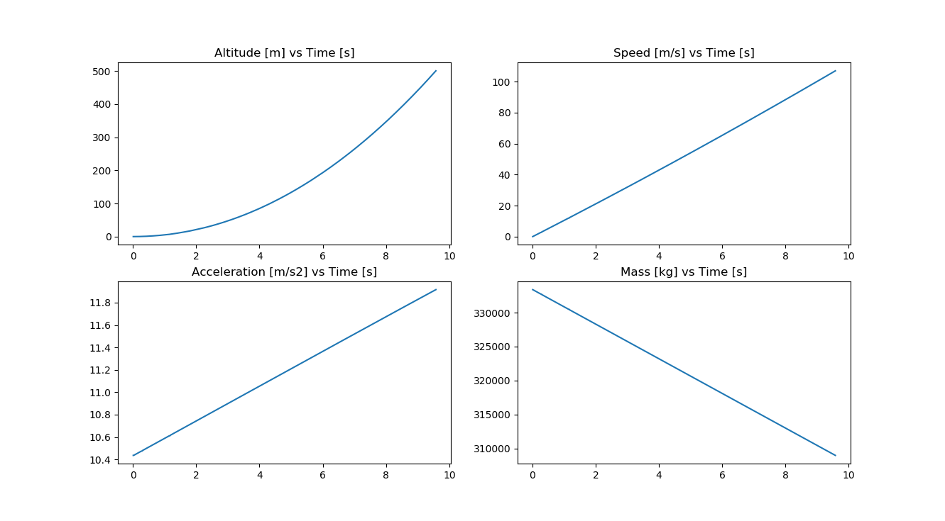

Explanation of the Workshop
The goal is to run the simulation and eventually to construct the rocket launch characteristic data:
?
?
?
?

Slide 8
Explanation of the Workshop
What we expect from you:
Calculate the forces from the Free Body Diagram.
Find the vertical acceleration of the rocket.
Update the mass numerically.
Read the instructions on the handout and the comments in Python carefully!

Slide 9
Python Crash Course
Variable assignment:
>>> x = 4
>>> x
4
Notes:
https://storage.googleapis.com/molten/lava/2018/09/81bb9282-intro-to-python-for-data-science-python-cheat-sheet-datacamp.jpg

Slide 10
Python Crash Course
Basic calculations:
>>> x+3
7
>>> x-3
1
>>> x/3
1.3333333333333333
>>> x*3
12
>>> x**3
64
>>> x%3
1
Notes:
https://storage.googleapis.com/molten/lava/2018/09/81bb9282-intro-to-python-for-data-science-python-cheat-sheet-datacamp.jpg

Slide 11
Python Crash Course
Conditions:
>>> x==3
False
>>> x!=3
True
>>> x<3
False
>>> x<=3
False
>>> x>3
True
>>> x>=3
True
Notes:
https://storage.googleapis.com/molten/lava/2018/09/81bb9282-intro-to-python-for-data-science-python-cheat-sheet-datacamp.jpg

Slide 12
Python Crash Course
Tips and Tricks:
Comments start with ‘#’.
Indentations matter! Use ‘tab’ if necessary.
To run the code: press ‘F5’.
Use the assigned variable name instead of the value itself!
Notes:
https://storage.googleapis.com/molten/lava/2018/09/81bb9282-intro-to-python-for-data-science-python-cheat-sheet-datacamp.jpg

Slide 13
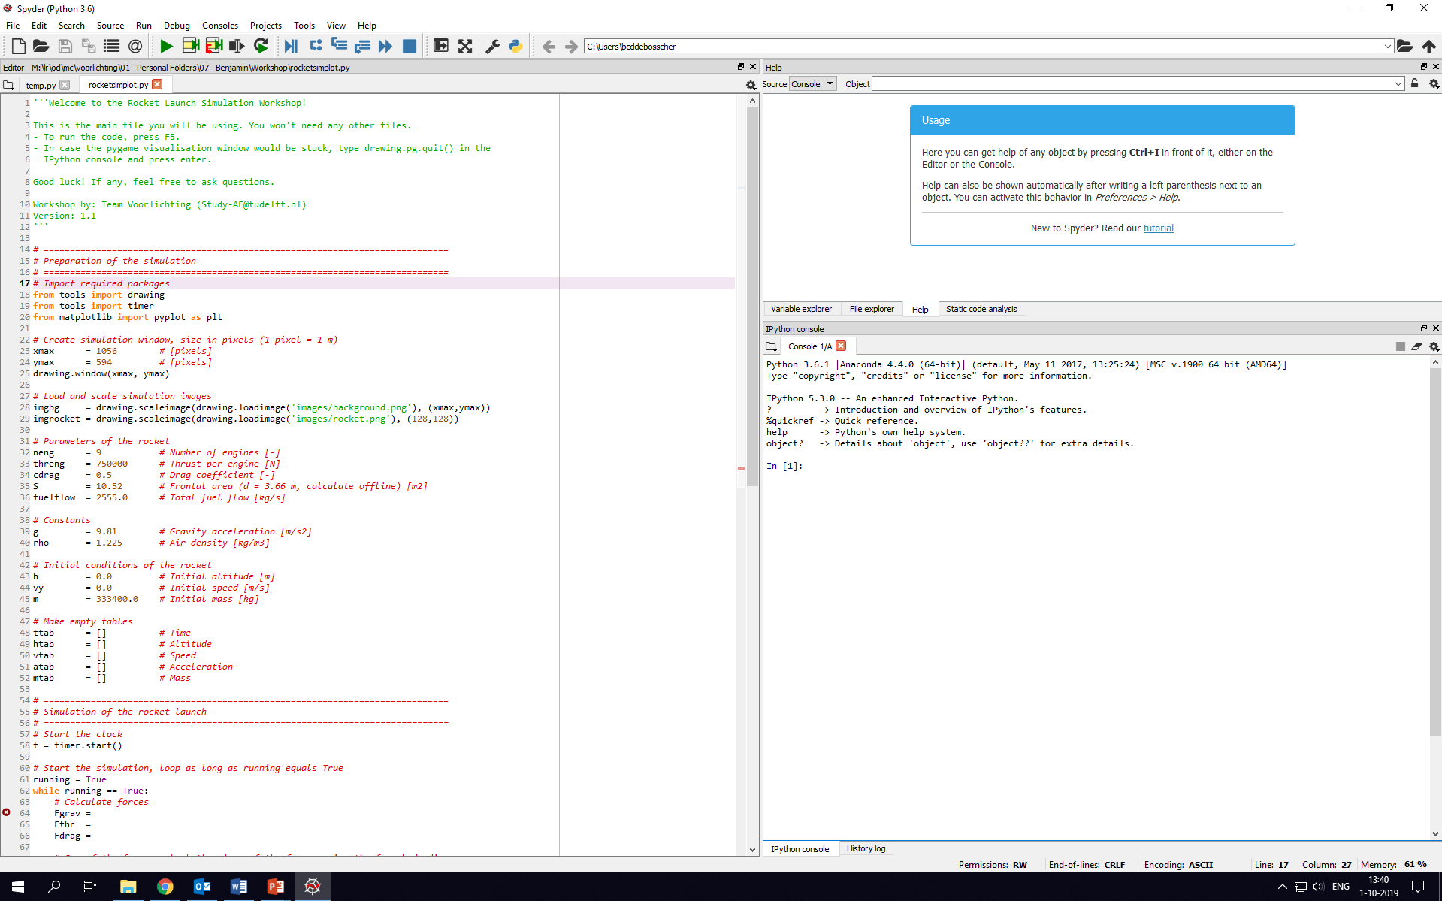
Final Instructions
You should see this:

Slide 14
Final Instructions
Spyder, the IDE that we will use:
Shell
Editor

Slide 15

Good Luck!
Read the instructions on the handout and the comments in Python carefully!
There are no stupid questions...

Slide 16
Solution

